Slide 1
October 2023
Introduction to C++:
Workshop Four
Dr. Alexander Hill
a.d.hill@liverpool.ac.uk

Slide 2
Last Week
Classes

Slide 3
Aim of Workshop Four
Homework recap
Monte Carlo and Markov Chains

Slide 4
Resources
alex-hill94.github.io/#WS5
https://www.w3schools.com/cpp/cpp_classes.asp
History of Monte Carlo - https://library.lanl.gov/cgi-bin/getfile?00326866.pdf
Basics of Monte Carlo Simulations - https://www.youtube.com/watch?v=OgO1gpXSUzU

Slide 5
Challenge Eight (Homework)
Create a class called Country with attributes:
Population, size, national language
Include a method called Greet, which outputs “Hello!”
In main(), create objects from the country class called: UK, France, Spain
Use constructors to initialise the attributes mentioned above
Print all attributes and run Greet
Bonus: inside Greet include an ‘if’ statement that changes language based on the national language

Slide 6
Ana & Khang
#include <iostream>
using namespace std;
class country {
public:
int population;
int size;
string nat_lang;
country(int pop, int sz, string language) {
population = pop;
size = sz;
nat_lang = language;
}
void greet() {
if (nat_lang=="english")
{cout << "hello" << endl;}
if (nat_lang=="francais")
{cout << "salut" << endl;}
if (nat_lang=="espagnol")
{cout << "hola" << endl;}
}
};
int main() {
country uk(10, 20, "english");
country france(50, 90, "francais");
country spain(40, 60, "espagnol");
Good practice to include an error message if non of the if statements are true
class Country{
public: // Access specifier
int population; // Attribute (int variable)
double size; // Attribute (double variable)
string nat_lang; // Attribute (string variable)
//Constructors
Country(int pop, double size_num, string lang){ // Constructor with parameters
population = pop, size = size_num, nat_lang = lang;}
//method Greet
void Greet(){
if (nat_lang == "English"){cout << "In English: Hello!" << endl;}
if (nat_lang == "French"){cout << "En Francais: Bonjour!" << endl;}
if (nat_lang == "Spanish"){cout << "En Espanol: Hola!" << endl;}
}
};
Else if (elif) preferable for more data-intensive applications

Slide 7
Emily
class Country {
public:
int population;
double size;
string language;
// Constructor to initialize the attributes
Country(int x, double y, string z) {
population = x;
size = y;
language = z;
}
void greet() { //if statement selects greeting based on language
cout << "Somebody says ";
if (language == "English") {
cout << "hello!";}
else if (language == "French") {
cout << "bonjour!";}
else if (language == "Spanish") {
cout << "hola!";}
else {
cout << "hi!";}
cout << endl;
}
};
UK population = 66971411
UK size = 242495 km^2
UK language = English
Somebody says hello!
France population = 68042591
France size = 643801 km^2
France language = French
Somebody says bonjour!
Spain population = 48345223
Spain size = 505994 km^2
Spain language = Spanish
Somebody says hola!

Slide 8
Andrew
Good use of ‘getter’
class Country
{
private:
int population;
int area;
string language;
public:
Country(int pop, int a, string lang)
{
population = pop;
area = a;
language = lang;
}
void print()
{
cout << "Population: " << population << endl;
cout << "Area: " << area << endl;
cout << "Language: " << language << endl;
}
void greating()
{
print();
if (language == "English")
{
cout << "Hello!" << "\n" << endl;
}
else if (language == "French")
{
cout << "Bonjour!" << "\n" << endl;
}
else if (language == "Spanish")
{
cout << "Hola!" << "\n" << endl;
}
else
{
cout << "你好!" << "\n" << endl;
}
}
};

Slide 9
Joe
class Country {
private:
// Data is private so can only be accessed with getData. It is a struct to avoid having many get() functions
struct {
string name;
float population;
double size;
string language;
} data;
public:
// Get data from the object's private struct. I wanted to set up a template for this but I couldn't figure it out, so I pass an integer parameter instead
void getData(int parameter){
Interesting use of struct!
// Depending on the parameter, print different information
switch (parameter) {
case 0:
cout << data.name << ":" << endl;
break;
case 1:
cout << "Population: " << data.population << " Million" << endl;
break;
case 2:
cout << "Area: " << data.size << " km²" << endl;
break;
case 3:
cout << "Language: " << data.language << endl;
break;
}
}
Notes:
What does ‘switch’ do?

Slide 10
Structs
struct Point {
int x;
int y;
};
int main() {
Point p1;
p1.x = 10;
p1.y = 20;
std::cout << "Point p1: (" << p1.x << ", " << p1.y << ")" << std::endl;
return 0;
}
Similar to classes
Used mainly to group similar/related data
Structs can only inherit from other structs, not classes

Slide 11
Marina
#include <iostream>
using namespace std;
class Country {
public:
double pop; // in millions
double size; //in km^2
string lang;
void Greet(){
if (lang=="English")
cout << "Hello!" << endl;
else if (lang=="French")
cout << "Bonjour!" << endl;
else if (lang=="Spanish")
cout << "Hola!" << endl;
else
cout << "Hello!" << endl;
}
Country(double p, double s, string l){
pop=p;
size=s;
lang=l;
}
};
void print_attr(Country x);
int main(){
Country UK(67.33,243610,"English");
Country France(67.75,551695,"French");
Country Spain(47.42,506030,"Spanish");
cout << "UK:" << endl;
print_attr(UK);
cout << "France:" << endl;
print_attr(France);
cout << "Spain:" << endl;
print_attr(Spain);
return 0;
}
void print_attr(Country x){
x.Greet();
cout << "Population: " << x.pop << " million" << endl;
cout << "Size: " << x.size << " square kilometers" << endl;
cout << "National Language: " << x.lang << endl;
cout << endl;
}
Pass in class object, cool!

Slide 12
Rupesh & Sakrican
class Country {
public:
void Greet() {
cout << "Hello!" << endl;
};
int population; // Attribute (integer)
double size; // Attribute (float): Area in square miles
string n_language; // Attribute (natitional language)
Country(int x, double y, string z){
population = x;
size = y;
n_language = z;
}
};
class Country {
public:
int Population;
double Size;
string National_language;
Country(int x, double y, string z){
Population = x;
Size = y;
National_language = z;
}
void Greet() {
cout << "Hello!\n";
}
};

Slide 13
Sinead
class Country {
public:
string name;
string national_language;
int population;
int size;
Country(string a, string x, int y, int z) {
name = a;
national_language = x;
population = y;
size = z;
}
void Greet() {
if (national_language == "English") {
cout << "Hello" << endl;
}
else if (national_language == "Spanish") {
cout << "Hola" << endl;
}
else {
cout << "Bonjour" << endl;
}
}
};
Bonjour
In France: National Language is French, Population is 68043591, Size is 643801
Hello
In the UK: National Language is English, Population is 66971411, Size is 242495
Hola
In Spain: National Language is Spanish, Population is 48345223, Size is 505994
🇫🇷

Slide 14
Challenge Nine
Download https://alex-hill94.github.io/Workshop/Intro_to_C++/soln.cpp
Adapt this script so that the write_out function is replaced with a class
Use the constructor to create the data.py file, and use a method within the class to save the vectors

Slide 15
Headers
To avoid your script becoming too verbose, you can save useful functions and classes in a header file
Save this file as my_funcs.h, and import using #include "funcs.h"

Slide 16
Monte Carlo Methods
History, general concepts
Quick example
Other examples
Markov Chains

Slide 17
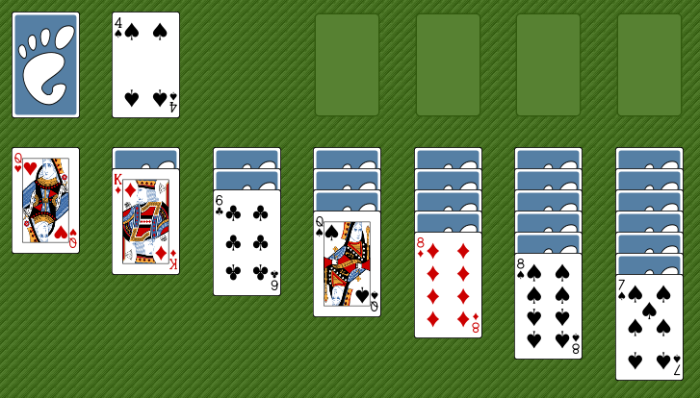
Monte Carlo History
Initially created by Stanislaw Ulam, Polish-American scientist
While ill, he wanted to know the probability of winning a game of solitaire
Finding the pure calculations too hard, he adopted a statistical approach
Playing the game would take too long, so he asked von Neumann to simulate it on an early (huge) computer

Slide 18
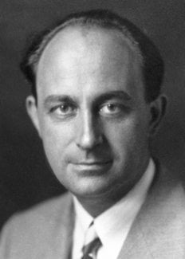
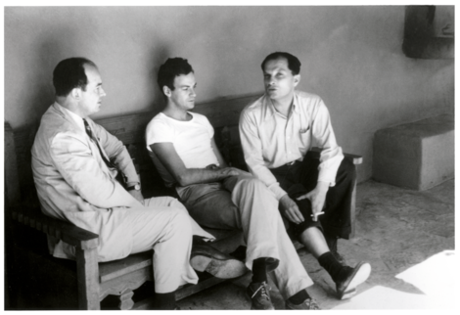
Monte Carlo History
Enrico Fermi
John von Neumann
Stanislaw Ulam
The Monte Carlo Method is a mathematical technique used to estimate the outcomes of an uncertain event
Developed during WWII in relation to the Manhattan project
Named after the Monte Carlo Casino, frequented by Ulam’s uncle, as chance is important to the modelling approach
Idea: use random sampling of inputs to explore outputs complex systems

Slide 19
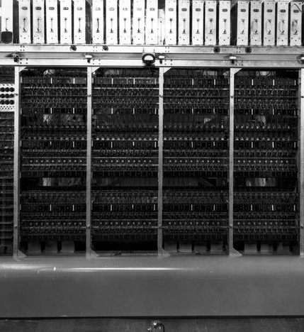

Monte Carlo History
The challenge of constructing the atom bomb involved neutron diffusion
Too challenging to be addressed analytically, needed a numerical approach
Some of the first computers tried an exhaustive numerical approach (plug in many numbers into the equation and calculate the result), but this was too slow due to high dimensionality of the problem
Monte Carlo methods were found to be remarkably successful
MANIAC Computer

Slide 20
Monte Carlo Basics
A method of estimating the value of an unknown quantity using the principles of inferential statistics
Key concepts:
Population: the universe of possible examples
Sample: a proper subset of a population
A random sample tends to exhibit the same properties as the population from which it is drawn
Use the sample to infer the statistics of the population
As the variance of the population increases, the more samples are needed to reach the same degree of confidence

Slide 21
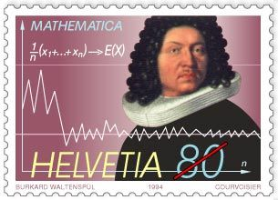
Law of Large Numbers
Law of large numbers:
In repeated independent tests with the same probability, p, of a particular outcome in each test, the chance that the fraction of times that the outcome occurs differs from p converges to zero as the number of trials goes to infinity
Notes:
Jacob Bernoulli

Slide 22
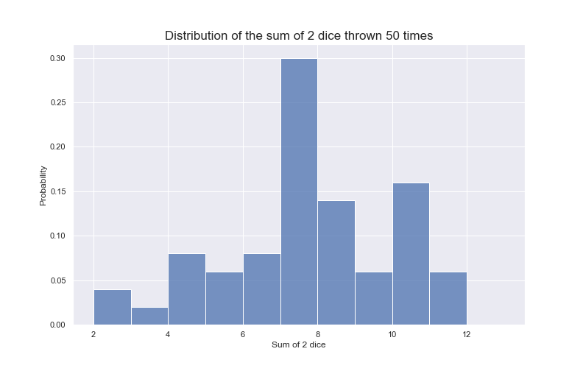
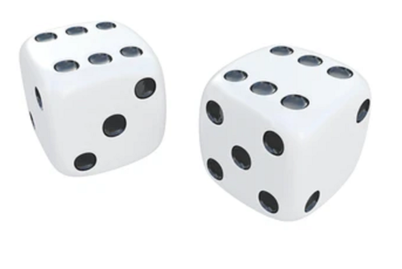
Law of large numbers
Example: roll two dice to predict probability of getting a given number in total

Slide 23
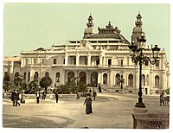
Gambler’s Fallacy
This is the idea that following a statistically unlikely set of results (e.g. many instances of red in a row in roulette), people believe that the next sample will work to bring you back to the average
Example in 1913 at Monte Carlo casino: after 15 blacks in a row, there was a rush to bet on red
After 26 reds in a row, the casino had made a fortune

Slide 24
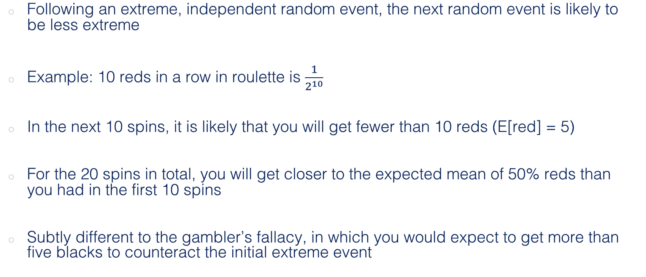
Regression to the Mean
Following an extreme, independent random event, the next random event is likely to be less extreme
Example: 10 reds in a row in roulette is $\frac{1}{2^{10}}$
In the next 10 spins, it is likely that you will get fewer than 10 reds (E[red] = 5)
For the 20 spins in total, you will get closer to the expected mean of 50% reds than you had in the first 10 spins
Subtly different to the gambler’s fallacy, in which you would expect to get more than five blacks to counteract the initial extreme event

Slide 25
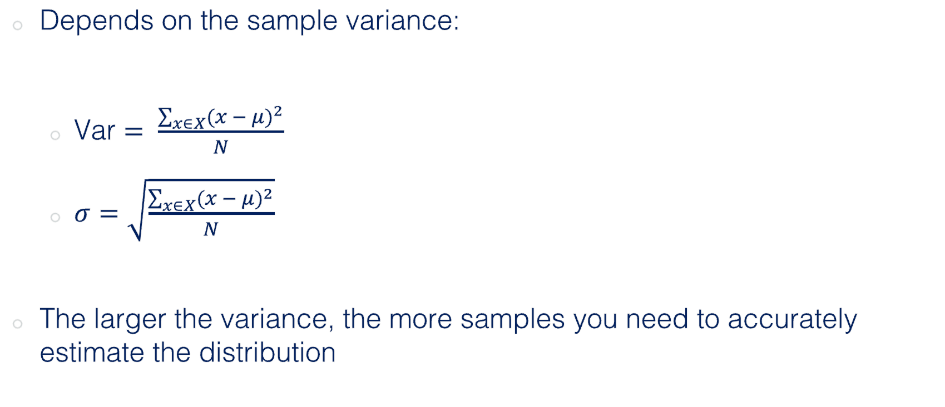
How many samples do we need?
Depends on the sample variance:
Var $= \frac{\sum_{x∈X}{{(x − μ)}^{2}}}{N}$
$σ=\sqrt{\frac{\sum_{x∈X}{{(x − μ)}^{2}}}{N}}$
The larger the variance, the more samples you need to accurately estimate the distribution

Slide 26
Gaussian Sampling
Assuming that positive error is as likely as negative, and that the distribution of errors in the estimate is normal
~68% of data is within one standard deviation of the mean
~95% is within 1.96 standard deviations (sometimes described as the confidence interval)
~99.7% of data is within 3 standard deviations of the mean

Slide 27
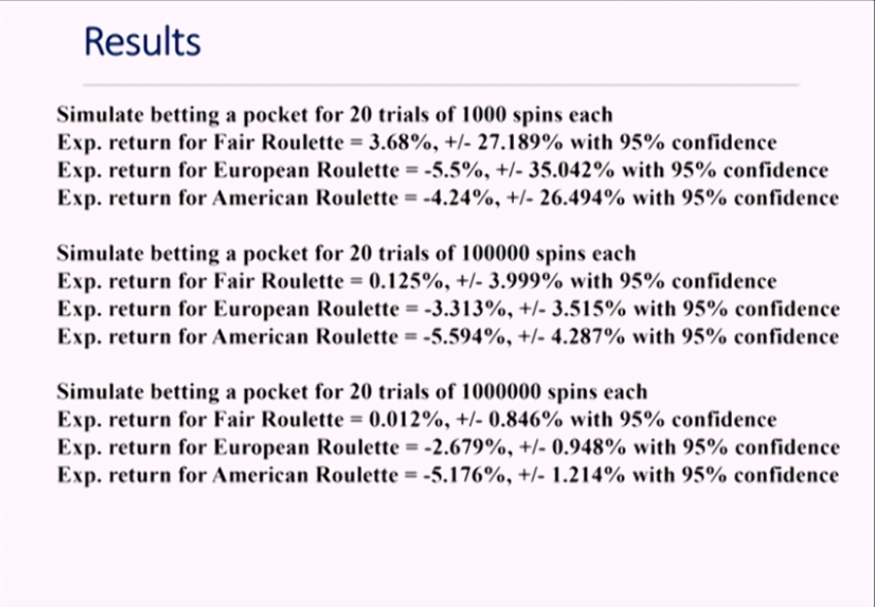

Slide 28

Monte Carlo Experiments
Generate random inputs according to some distribution
Use these to conduct an experiment
Analyse the output using statistics and make predictions of the simulation’s or process’ properties

Slide 29

Monte Carlo Examples
Business applications:
Estimate probability of cost overrun in large projects
Estimate likelihood of an asset gaining/losing value
Path tracing in video games (trace random samples of possible light paths)
AI for video games (tree search for next best move)
Computational physics, physical chemistry
E.g. Monte Carlo molecular modelling: generate states according to a Boltzmann distribution

Slide 30
Random Numbers
For random events, the probability that any given random event occurs is given via probability distribution function
This captures the notion of relative frequency with which random events occur
For discrete random events (heads, tails), the sum of the probability of each value occurring must add up to one
For continuous events (temperature) it’s trickier, as we can’t give infinite real numbers separate probability values

Slide 31
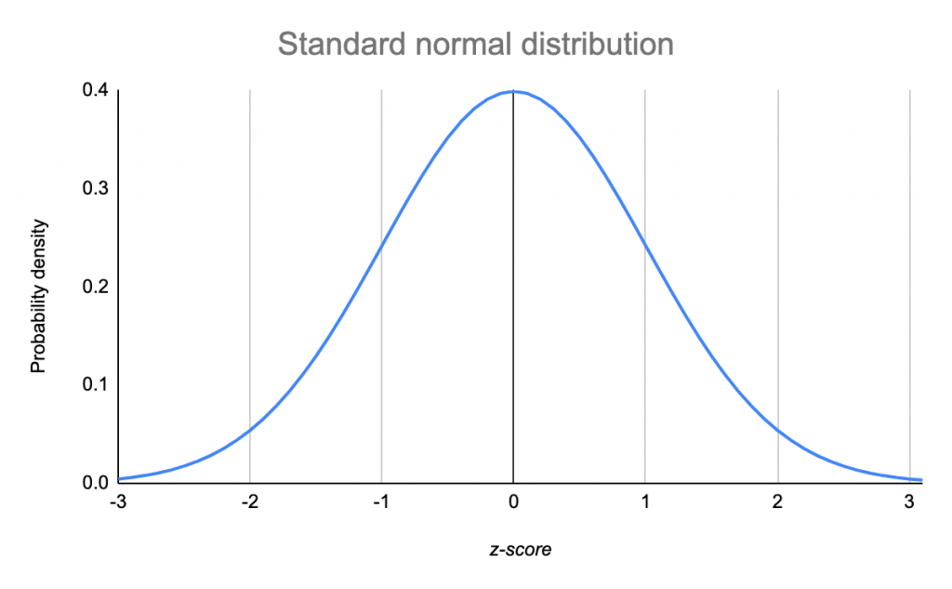
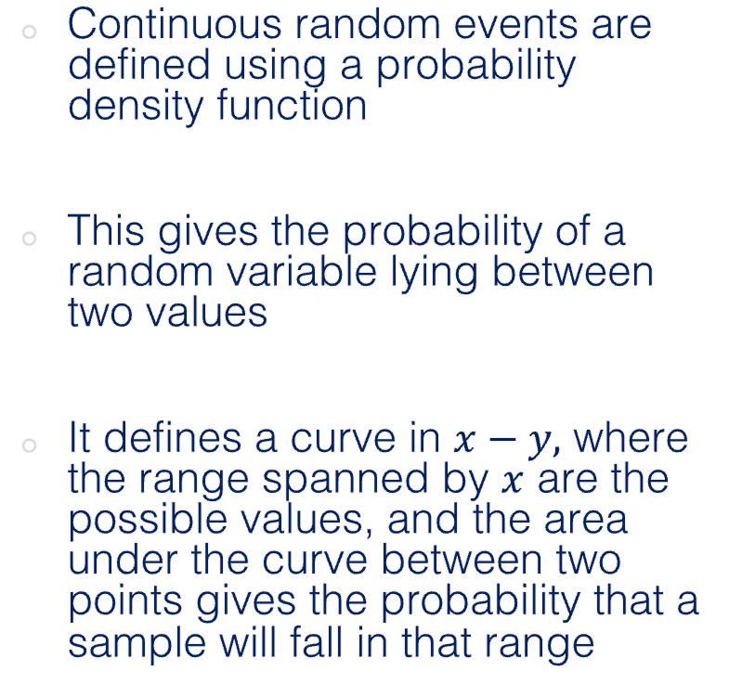
Continuous random variables
Continuous random events are defined using a probability density function
This gives the probability of a random variable lying between two values
It defines a curve in $x−y,$ where the range spanned by $x$ are the possible values, and the area under the curve between two points gives the probability that a sample will fall in that range

Slide 32

Generating Random Numbers in C++
We’ll use the <random> header to generate random numbers (https://cplusplus.com/reference/random/)
This uses Generators and Distributions to generate random numbers
Generator: an object that generates uniformly distributed numbers
Distribution: an object that transforms sequences of generated numbers in to numbers numbers that follow a specific random variable distribution

Slide 33
Generating Random Numbers in C++
Create a random number seed
Create a generator using the seed
Create a distribution object
Pass the generator into the distribution

Slide 34
Generating random numbers in C++
Generator: mersenne twister random number engine
Start and end points
#include <iostream>
#include <vector>
#include <random>
using namespace std;
int main(){
const int range_from = 0;
const int range_to = 1000;
random_device rand_dev;
mt19937 generator(rand_dev());
uniform_int_distribution<int> distr(range_from, range_to);
cout << distr(generator) << '\n';
return 0;
}
Seed: this creates a random device object, which is used to seed the random number generator
Uniform integer distribution
Distribution definition
Distribution takes Generator as argument to produce random number

Slide 35
Example
#include <iostream>
#include <vector>
#include <random>
#include <cmath>
#include <fstream>
#include "funcs.h"
using namespace std;
int main(){
int n_sim_runs = 1e5;
vector<double> inputs(n_sim_runs);
vector<double> outputs;
string fname = "data.py";
string xname = "x_range";
string yname = ”y_range";
for (auto i = 0; i < inputs.size(); ++i){
rnum(inputs.at(i));
}
simulation(inputs, outputs);
write_out_vec(fname, xname, inputs);
write_out_vec(fname, yname, outputs, false);
system("ipython test.py &");
return 0;
}
Some auxiliary functions I’ve made
A ‘simulation’ takes one input (uniform dist.) and produces one output
What is the output distribution?
Create inputs with length ‘n’
Blank outputs
Replaces inputs elements with random numbers
Runs ‘simulation’, outputs is now the simulation’s output
Writes out data
Runs plotting python script

Slide 36
Example
void rnum(double& input){
const double range_from = -1000;
const double range_to = 1000;
random_device rand_dev;
mt19937 gen(rand_dev());
uniform_real_distribution<double> distr(range_from, range_to);
input = distr(gen);
}
Random number function takes an element the the input vector, and makes it a random float between -1000 and 1000

Slide 37
Example
Input is fixed, output can change
void buffer(const double& input, double& output){
// Computes a polynomial from a given input, modifies the output accordingly
output = pow(input, 3) - 3*pow(input, 2) + 9.2 * pow(input,1) + 4.3;
}
void simulation(const vector<double>& input, vector<double>& output)
{
// Simulation loops over inputs and modifies the output vector
double temp_val;
for (auto i: input){
buffer(i, temp_val);
output.push_back(temp_val);
}
}

Slide 38
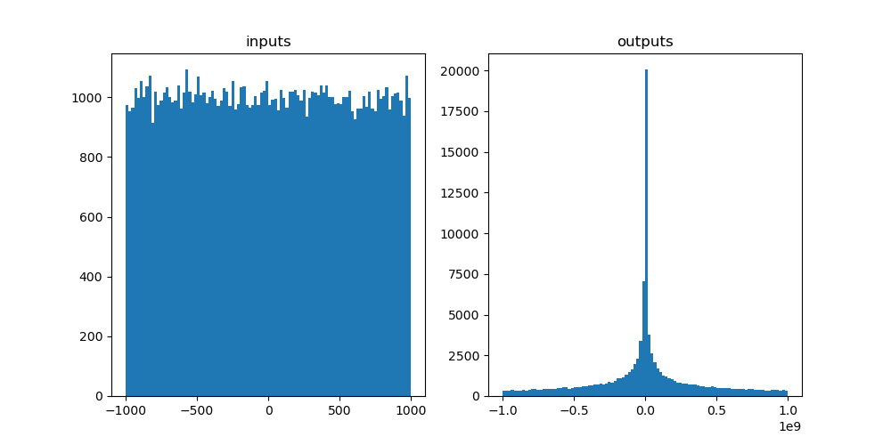
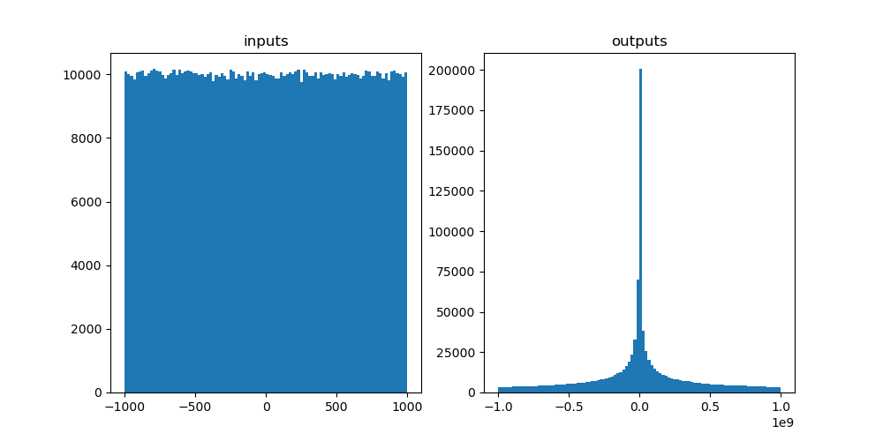
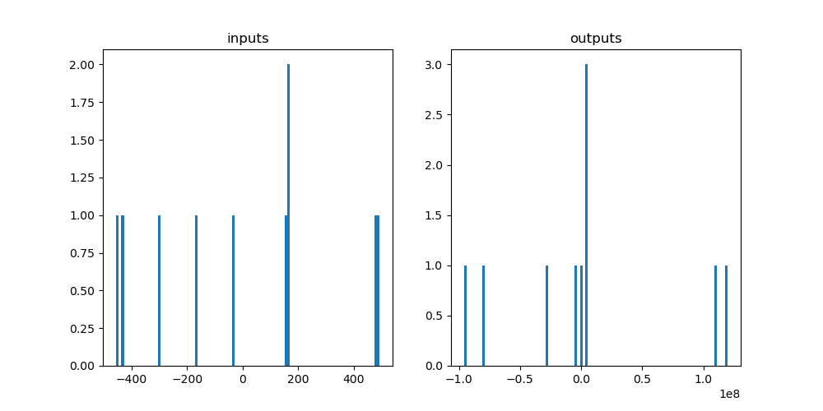
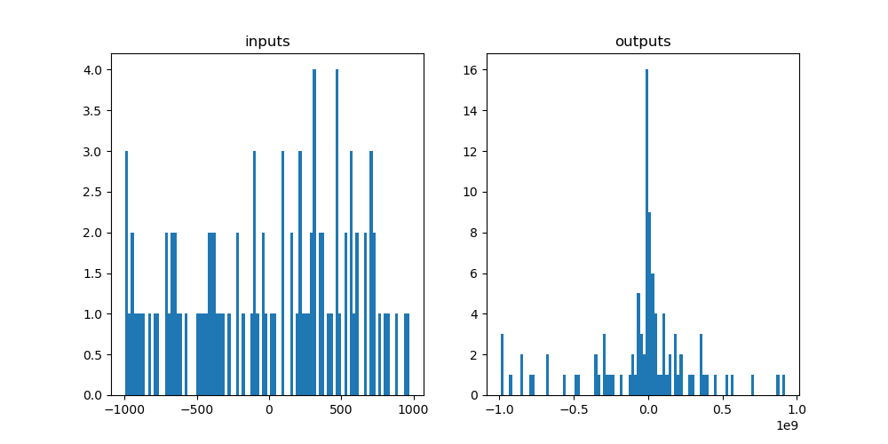
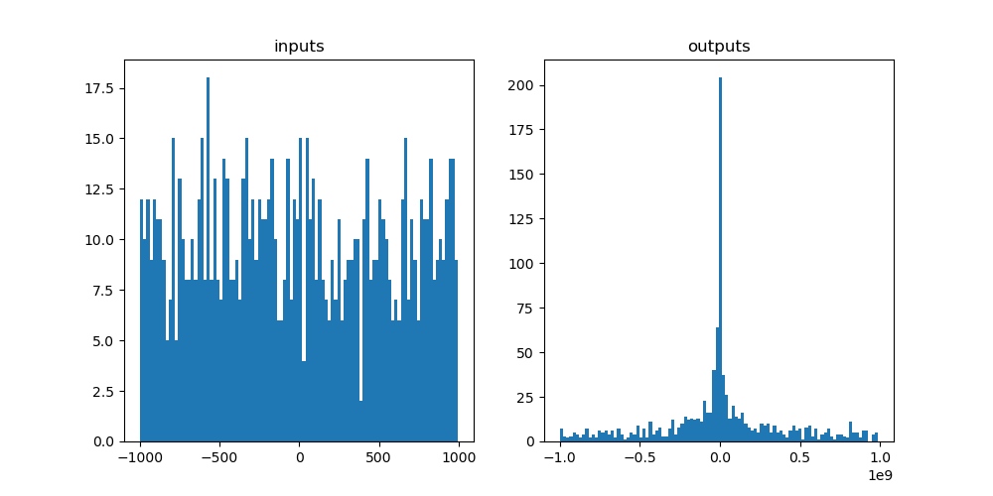
Example
1e1 -> 1e6 draws

Slide 39
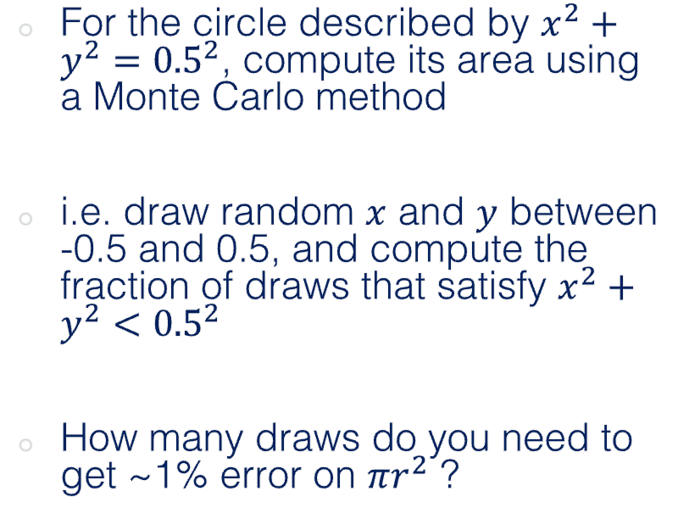
Challenge Ten: Area of a Circle
0.5
For the circle described by $x^{2}+y^{2}={0.5}^{2}$, compute its area using a Monte Carlo method
i.e. draw random $x$ and $y$ between -0.5 and 0.5, and compute the fraction of draws that satisfy $x^{2}+y^{2}<{0.5}^{2}$
How many draws do you need to get ~1% error on $πr^{2}$ ?
-0.5
0.5
-0.5

Slide 40
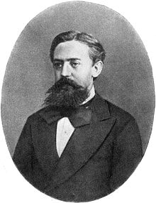
Markov Chain Monte Carlo (MCMC)
Monte Carlo: estimate the expected value or probability density of some unknown space by drawing independent random values
For high-dimension probabilistic models, Monte Carlo sampling may not be effective, as volume of sample space grows exponentially with additional parameters
MCMCs try to sample more intelligently, the next random draw depends on the current one
Andrey Markov

Slide 41
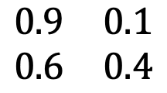
Markov Chains
0.9
A simple Markov Chain uses stochastic processes to determine the evolving state of a system
Consider this system, it describes whether someone attends class given their previous attendance
E.g. if you attend class one week, there’s a 90% chance you will the next
Attend
0.1
0.6
TO
Skip
attend
skip
0.4
attend
$$\begin{matrix}0.9 & 0.1 \\ 0.6 & 0.4\end{matrix}$$
FROM
skip
Transition matrix

Slide 42
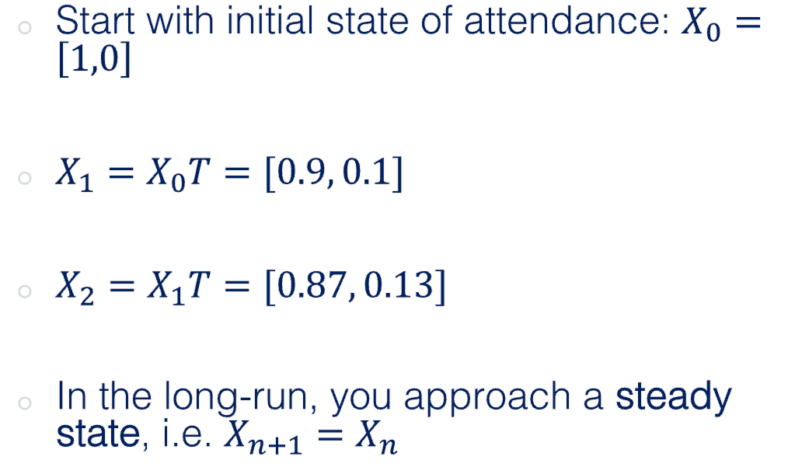
Markov Chains
0.9
Start with initial state of attendance: $X_{0}=\left[1,0\right]$
$X_{1}=X_{0}T=[0.9, 0.1]$
$X_{2}=X_{1}T=[0.87, 0.13]$
In the long-run, you approach a steady state, i.e. $X_{n+1}=X_{n}$
Attend
0.1
0.6
TO
Skip
attend
skip
0.4
attend
$$\begin{matrix}0.9 & 0.1 \\ 0.6 & 0.4\end{matrix}$$
FROM
skip
Transition matrix

Slide 43
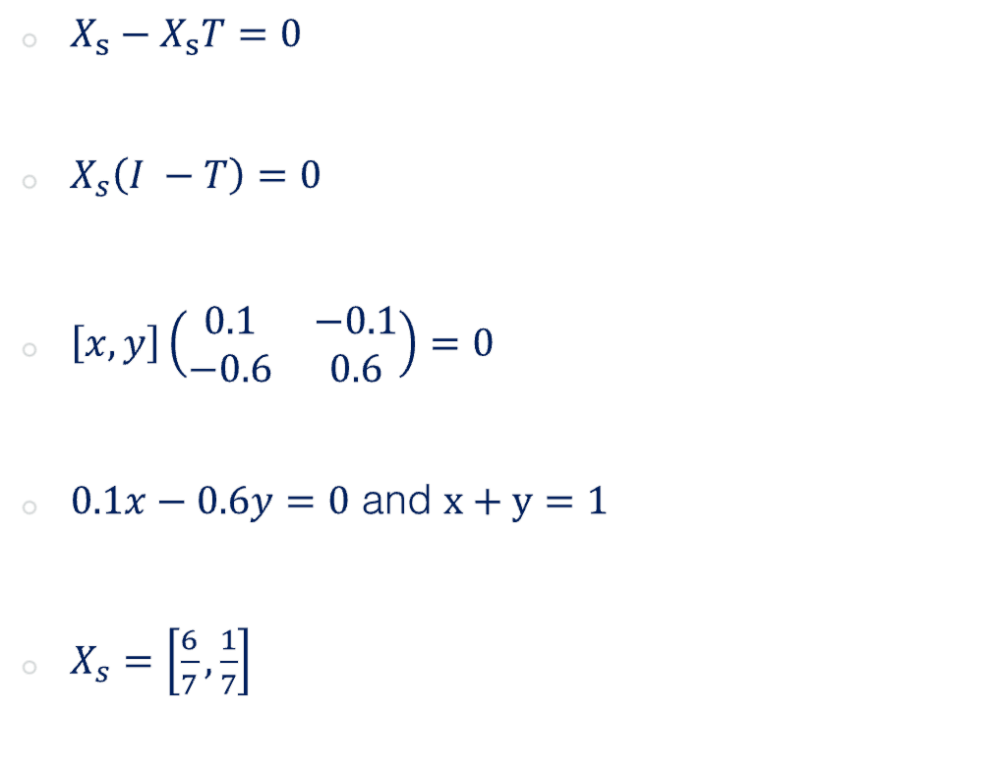
Markov Chains
0.9
$X_{s}−X_{s}T=0$
$X_{s}\left(I −T\right)=0$
$\left[x, y\right]\left(\begin{matrix}0.1 & −0.1 \\ −0.6 & 0.6\end{matrix}\right)=0$
$0.1x−0.6y=0$ and $x+y=1$
$X_{s}=\left[\frac{6}{7},\frac{1}{7}\right]$
Attend
0.1
0.6
TO
Skip
attend
skip
0.4
attend
$$\begin{matrix}0.9 & 0.1 \\ 0.6 & 0.4\end{matrix}$$
FROM
skip
Transition matrix

Slide 44
Markov Chains
Markov chains can also be used to generate a sequence of random variables where the current value is dependent on the value of the prior value
An example of this is a number line, where possible moves are -1 and 1 (chosen with equal probability)
MCMCs are Monte Carlo methods where a Markov chain is used to draw samples
The idea is that the chain will settle (find equilibrium) on the desired quantity we are inferring

Slide 45
Challenge Eleven
Create a class that generates random numbers from a uniform distribution
Create a Markov Chain class that predicts which US party will win the next election (lookup matrices, matrix mutliplication, if statements etc.)
Assume initially a Dem is in power X0 = [1,0], create a method in the MC class that calculates numerically the steady state vector, i.e. the probability that in a given year the holder will be Democrat or Republican
Create another method that uses random draws from the random number class to stochastically predict who will be in power for each of the next 20 cycles
Create a figure showing how the holder of office changed over the 20 cycles
0.76
Democrat
0.24
0.35
Republican
0.65

Slide 46
Next week
Introduction to you group project

Slide 47
Thanks!

